Slide 1
EMPLOYEE MANAGEMENT SYSTEM

Slide 2
ABSTRACT
Employee management System is a distributed application, developed to maintain the details of employees working in any organization. It maintains the information about the personal details of their employees, also the details about the payroll system which enable to generate the pay slip.
The application is actually a suite of applications developed using Java. This software package has been developed using the powerful coding tools of JAVA at Front End and Microsoft Sql Server at Back End .
The software is very user friendly. The package contains different modules like Employee details. Employee management system is an application that enables users to create and store Employee Records. The application also provides facilities of a payroll system which enables user to generate Pay slips too.
This application is helpful to department of the organization which maintains data of employees related to an organization .

Slide 3
HARDWARE SPECFICATION
Processor : P 4 700 GHz.
RAM : 4 GB RAM
Hard Disk Drive : 180 GB

Slide 4
SOFTWARE SPECIFICATION
Operating System : Windows 7/8/10
Front End : JAVA
Back End : SQL

Slide 5
EXISTING SYSTEM
In this existing system very hard to managing the employees manually. Sometimes it has taken more to search one particular employees. This will take too much time to find one employee.
Disadvantages
It takes too much time to find employee
Can’t handle employee working hours
We can’t track the employee
Wasting paper based period

Slide 6
PROPOSED SYSTEM
This system will be overcome these kind of issue, which makes to find and employees details at any time. We can track the employee immediately. We can easily find the employee working hours also which may helps to find the employee who are taken leave on that day.
Advantages
Tracking employees details
Attractive interface
Every one can using this software.
Low cost and high benefit

Slide 7
Modules
Employee Registration
Salary management module
Leave Module
Attendance Module
Login Module
Employee Registration
This module has to used to collect the employee information and save into the database. Once the employee registration has been completed they will get username and password, when need to login just use this credential to move login page.

Slide 8
Login Module
Admin and employee both can login this portal. Every users have own credential. Which make secure to display the details.
Users can’t seen others users details.
Salary Management Module
Salary management module is used managing the salary details for employees.
Admin can manage all the employees salary details. Every month we can generate the pay slip by admin.

Slide 9
Leave Module:
Employee should sending the leave request before taking a leave. The request was accept by administrator. If the administrator does not accepting the leave request employee can’t to take a leave. So manager can find who are all taking a leave on today.
Attendance Module.
An Attendance module is main part of our project. Which could helps to find employees daily punch report, the we can manage our attendance report.

Slide 10

Data Flow Diagram
Level 0:

Slide 11
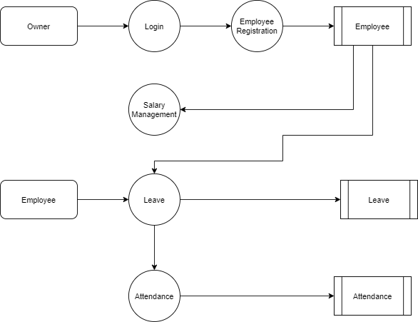
Level 1:

Slide 12
Thank You

